Slide 1
Community detection and clustering in large social networks

Slide 2
Community Detection
The search for the naturally occurring groups in a network regardless of their number or size, which is used primarily as a tool for discovering and understanding the large-scale structure of networks.
The basic goal of community detection is similar to that of graph partitioning. The important difference is that the number or size of groups is not fixed.

Slide 3
Community Detection
A good division is one where there are fewer than expected edges between groups.
The goal will be to find a measure that quantifies how many edges lie within groups in our network relative to the number of such edges expected on the basis of chance.

Slide 4
Spectral Modularity Maximization
Modularity :
has the property :

Slide 5
Spectral Modularity Maximization

Slide 6
Spectral Modularity Maximization

Slide 7
Spectral Modularity Maximization
For maximum modularity, we should choose s to the eigenvector u₁ corresponding to the largest eigenvalue of the modularity matrix.
Relaxation:

Slide 8
Division into more than Two Groups
Consider explicitly the change

Slide 9
Division into more than Two Groups
Note that the rows and columns of still sum to zero and that is correctly zero if group is undivided.

Slide 10
Division into more than Two Groups
Algorithm :
Divide the network into two parts according to the signs of the elements of this vector, and then repeat for each of the parts. If at any stage we find that the proposed split makes a zero or negative contribution to the total modularity, we leave the corresponding subgraph undivided. When the entire network has been decomposed into indivisible subgraphs in this way, the algorithm ends.

Slide 11
Other Algorithm for Community Detection
In the previous sections we have looked at algorithms based one particular definition in terms of the modularity function, but there are a number of other definitions in common use that lead to different algorithms.
1. Betweenness-based Methods
2. Hierarchical Clustering

Slide 12
Betweenness-based Methods
One alternative way of finding communities of vertices in a network is to look for the edges that lie between communities.
Edge betweenness : counts the number of geodesic paths that run along edges.

Slide 13
Betweenness-based Methods
Algorithm :
We calculate the betweenness scores of all edges in our network and then search through them for the edge with the highest score and remove it. As we remove one edge after another, an initially connected network will eventually split into two pieces, and then into three, and so on.

Slide 14
Betweenness-based Methods
The betweenness-based algorithm is, unfortunately, quite slow.
Edge betweenness can be calculated for all edges in time O(n(m+n)) (Section 10.3.6)
Need to remove O(m) edges.
This results in O(mn(m+n)) complexity.

Slide 15
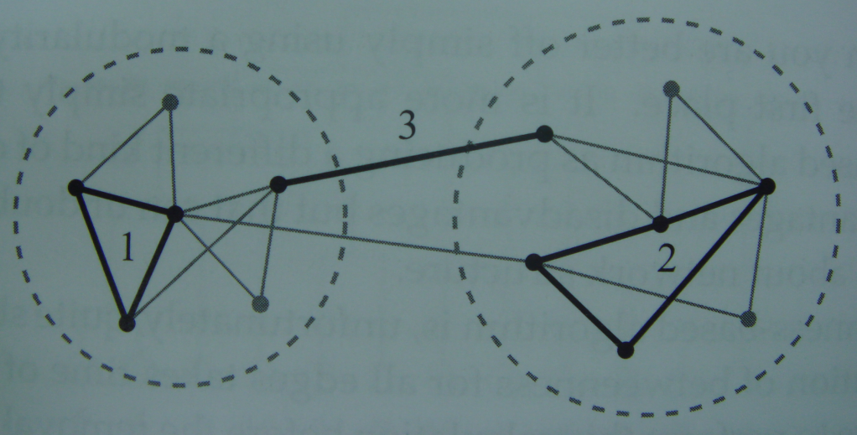
Betweenness-based Methods
An interesting variation on the betweenness algorithm has been proposed by Radicchi et al.
Use a different measure to identify between-group edges by looking for the edges that belong to the fewest short loops.

Slide 16
Hierarchical Clustering
The basic idea behind hierarchical clustering is to define a measure of similarity or connection strength between vertices, based on the network structure, and then join together the closest or most similar vertices to form groups.

Slide 17
Combining vertex similarities
Single-linkage clustering
the similarity between the two groups is defined to be the similarity of the most similar of these pairs of vertices.
Complete-linkage clustering
the similarity between two groups to be the similarity of the least similar pair of vertices.
Average-linkage clustering
the similarity of two groups to be the mean similarity of all pairs of vertices.

Slide 18
Hierarchical Clustering
Hierarchical clustering method is as follows :
1. Choose a similarity measure and evaluate it for all vertex pairs.
2. Assign each vertex to a group of its own, consisting of just that one vertex. The initial similarities of the groups are simply the similarities of the vertices.
3. Find the pair of groups with the highest similarity and join them together into a single group.

Slide 19
Hierarchical Clustering
4. Calculate the similarity between the new composite group and all others using one of the three methods above(single-, complete-, or average-).
5. Repeat from step 3 until all vertices have been joined into a single group.

Slide 20
Hierarchical Clustering
in the naive implementation
or if we use a heap.

